Slide 1
Joab – The Lord Will Repay
Class 1 : David’s Mighty Men
I Samuel 21:10 – 22:5
Notes:
Turbulent Life Story of Joab is intertwined with David
David is of course the primary character, but for these classes Joab is our primary interest
we are going to set the two men in parallel, and learn what made them so different
Success and Failure; Spiritual Lessons
Important moral and ethical questions
(Pics - Holy Land, c. 1000 - 600 BC. Long bronze spear point with leaf-shaped blade)
http://www.ancientresource.com/lots/holyland_artifacts/holy-land-weapons.html

Slide 2
David’s Rise to Fame:
Defeated Goliath (I Sam 17)
Member of King’s Court (I Sam 18:1-4)
Local Popularity (I Sam 18:6-8)
Commander of 1000 men (I Sam 18:13)
National Popularity (I Sam 18:14-16)
Notes:
-As we enter the story in progress, David is on the run for his life
-But first he is a local celebrity; young and famous
-Background information; we must review a lot of storyline in short time
-age 20’s or very early 30’s

Slide 3
Military Success Is Key:
In ancient culture, military success was by far the single, most important characteristic of a “good” leader.
Why?
Notes:
-Is this perception true? Yes and no, especially for ancient culture (harder to conceive)
-Leaders are, in fact, often built upon perception; A “kill or be killed” environment
-What does make a good leader? David’s other qualities?

Slide 4
I Sam 8:20:
“…That we also may be like all the nations, and that our king may judge us and go out before us and fight our battles.”
Notes:
-recall that lack of military strength was a feature of the Judges period
-Israel did not want this condition to persist, and a king was viewed to be the solution

Slide 5
The King Without a Kingdom:
Hated / Feared by Saul (I Sam 18:28-19:10)
Lost Home / Family (I Sam 19:11-18)
Lack of Food, Weapon (I Sam 21:1-9)
Insane, literally (I Sam 21:12-15)
Escape to Adullam (I Sam 22:1-2)
Notes:
-As a result of Saul’s disobedience, David has already been anointed king by Samuel (I Sam 16:1-13)
-But his life looks to be going the wrong way
-escaped by night with the help of his wife Michal
-no food, weapons (lied to Abimelech @ Nob), took Goliath’s sword (weapon of the flesh, he had left it until now)
-faked insanity (@ Gath)

Slide 6
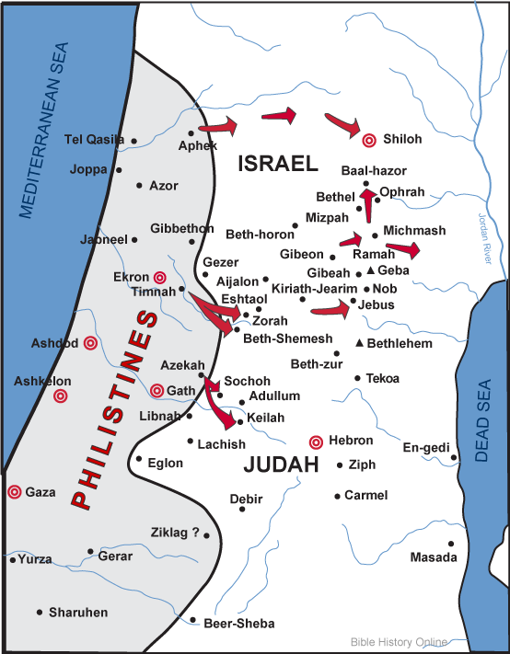
Philistine Conquests c. 1000BC:
Notes:
Map of the Philistines Areas of Expansion in Ancient Israel
http://www.bible-history.com/geography/maps/map_philistine_cities_expansion.html
-Review the area, particularly Gath, Adullam, Valley of Elah between
-Critical to understand how weak, unorganized, and outmanned the Jewish nation was at this time
-Their territory was very small, and they were in no way autonomous, they were subjects to any who would conquer them

Slide 7
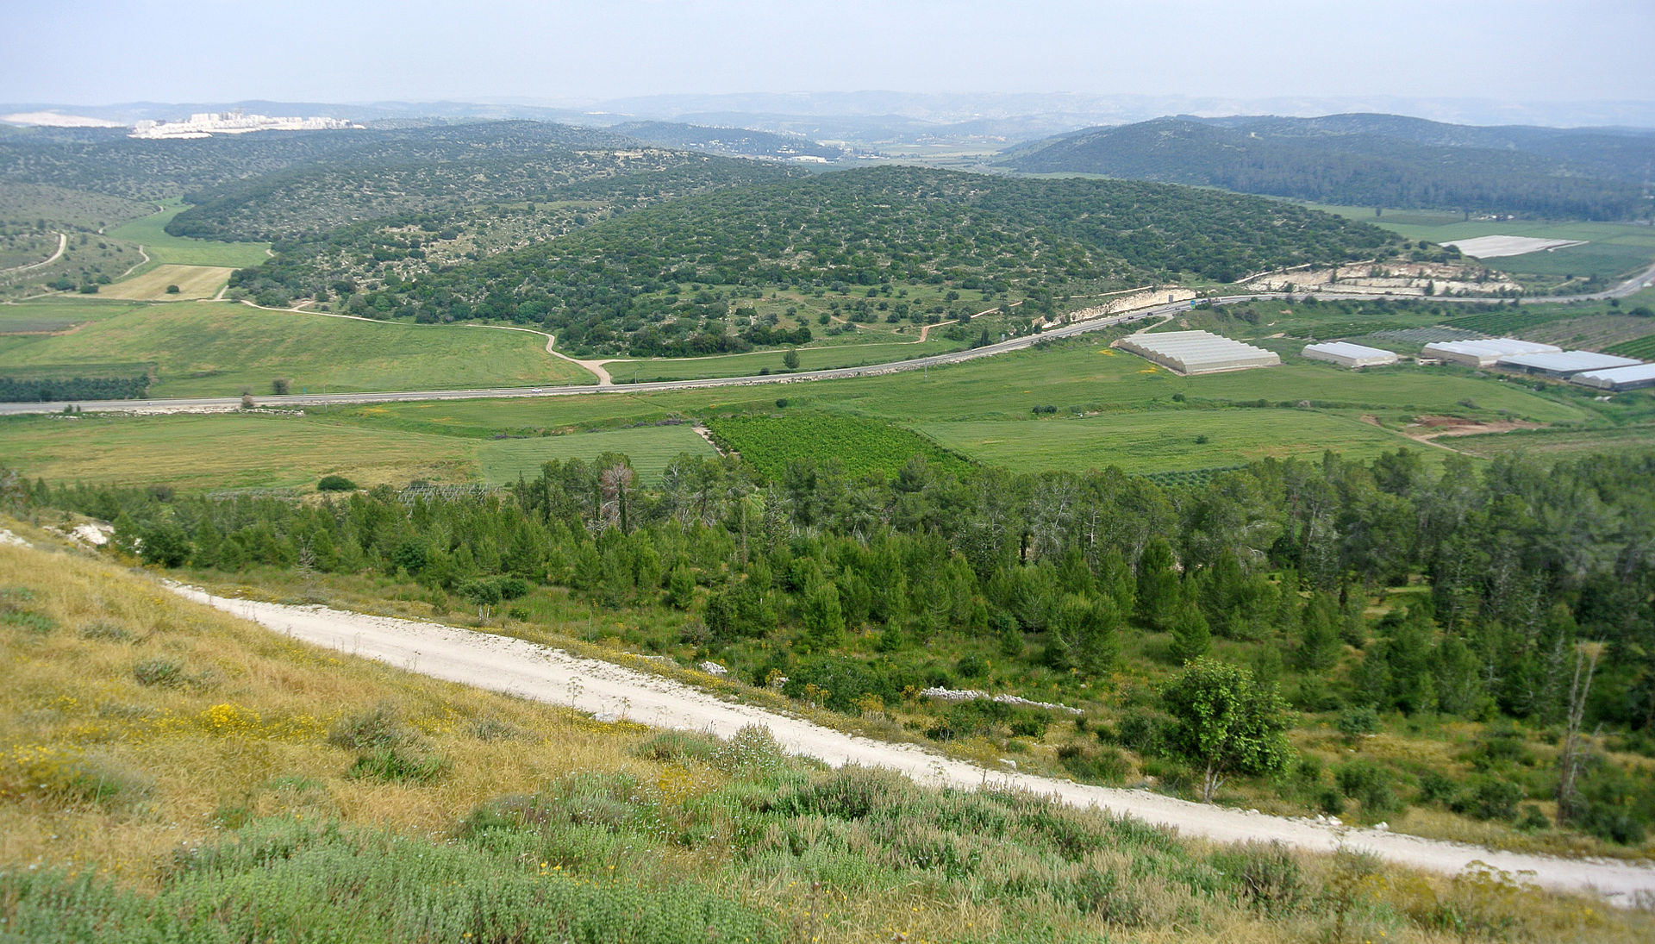
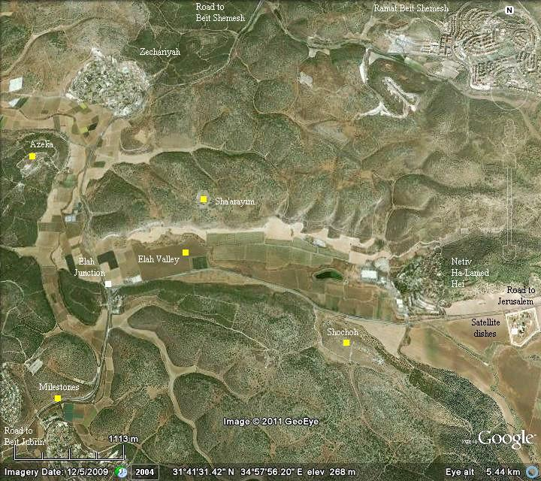
Adullam
The Valley of Elah
Notes:
-Ironic twist of fate as David flees from Gath through the valley to hide in Adullam
In the place where he defeated Goliath years prior
-Geography is key; high hills are strategic as you can see
-Main image – Valley as seen from Tel Azekah (X) looking west;
https://en.wikipedia.org/wiki/Valley_of_Elah
-Inset Left - Satellite view of Valley
http://www.biblewalks.com/sites/Sochoh.html

Slide 8
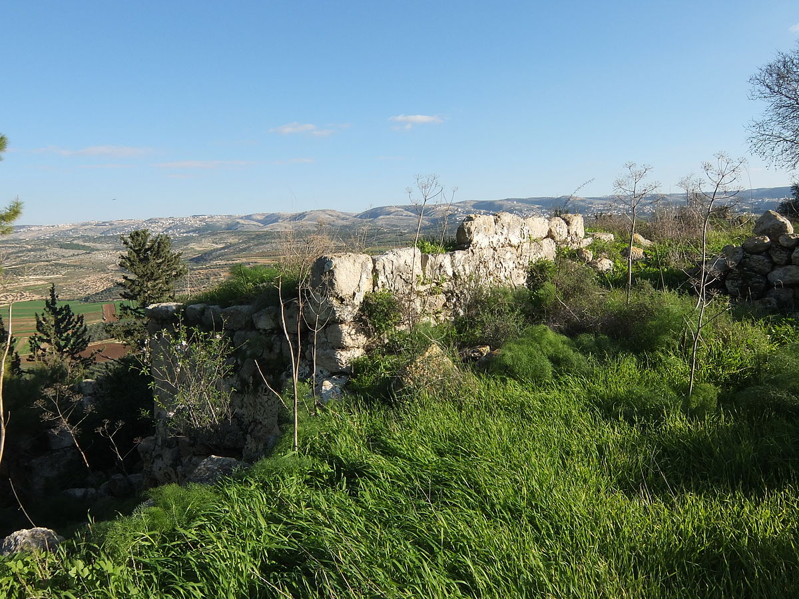
The Valley of Elah
Ruins of Adullam
Notes:
-very many caves in this area, rough terrain
-easy to hide, close to the Philistine border makes Saul’s search attempts more dangerous
-David’s men first meet him at Adullam
-As seen from atop the ruins of Adullam, looking east down to the valley
https://en.wikipedia.org/wiki/Adullam

Slide 9
I Sam 22:2:
“Everyone who was in distress, and everyone who was in debt, and everyone who was bitter in soul, gathered to him. And he became captain over them..about 400 men.”
Notes:
-David’s men first meet him at Adullam
-but what did David have to offer? Not money or influence, but strategic protection (ex-military commander).
-This was seen by these outcasts of society to be most important.
-These harbored anger, anxiety

Slide 10
Life On The Run:
מָצוּד (matsuwd); מְצָד (metsad)
‘fortress, hold, stronghold(s)’
Used several times in reference to
the hiding places of safety for David, e.g. caves, deserts, and walled cities
Notes:
-I Sam 22:4, 5 (Mizpeh in Moab); I Sam 23:14, 19 (Horesh in Ziph); I Sam 23:29, 24:22 (En Gedi); I Chron 12:8, 16 (Ziklag)
-David is a wanted fugitive, searching for strategic advantage and safety

Slide 11
Who Were These Outcasts?
Skilled Warriors (I Chron 11:10-47)
Physical Strength (v. 22-25)
Courage (v. 15-19)
Hundreds of kills (v. 11, 20)
David’s Extended Family
Brothers, and His Father’s House (I Sam 22:1)
Notes:
-Exceptional accomplishments in battle
-including David’s ‘brothers and all his father’s house’
David is a REAL LIFE Robin Hood!

Slide 12
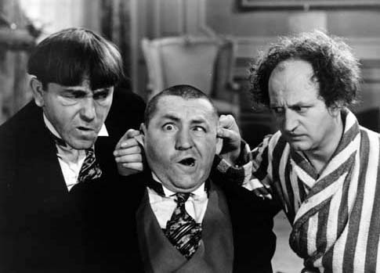
The Sons of Zeruiah:
Zeruiah, David’s Sister (I Chron 2:16)
Abishai, Asahel, Joab
Notes:
-Among these are the sons of Zeruiah
-These three play a prominent role in the rest of Davids life
-Cunning, proud, dangerous, dedicated
-They don’t play games! No three stooges!

Slide 13
The City of Keilah:
David’s first offensive (I Sam 23:1-14)
“Shall I go and attack?” (v. 2)
“Behold, we are afraid” (v. 3)
No turning back
Notes:
-Keilah robbed by Philistines
-This is David’s first offensive since leaving his military post and losing favor with Saul
-David made request of God via the ephod via Abiathar, the priest, who had joined his band
-David’s men are afraid, they have left homes and family but have nothing yet to show for it!
-They cannot hide in caves forever, it is literally do or die.

Slide 14
Philistine Conquests c. 1000BC:
Notes:
-Show from Adullam to Keilah
-David can monitor Philistine troop movements in the valley of Elah
from his vantage point at Adullam

Slide 15
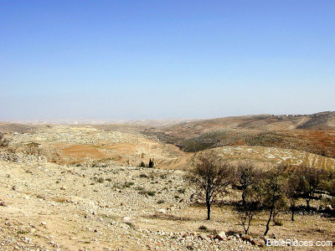
Success?
David saved Keilah (I Sam 23:5)
No gratitude, betrayal (v. 7-12)
David escapes to the wilderness (v. 13-14)
~200 men follow David (v. 13)
Notes:
-David was very successful in defeating the Philistines
-The people were glad, but soon willing to trade David to Saul for continued peace
-Davids escapes to empty wilderness, anticlimactic results, disheartening
-Adds ~200 men! A bright ray of hope
Image – The barren land of Ziph
http://bibleencyclopedia.com/places/Wilderness_of_Ziph.htm

Slide 16
The Wandering:
David betrayed twice more by Ziphites (I Sam 23:19, 26:1)
‘Missed’ Opportunities to kill Saul (I Sam 24, 26)
Returns to Gath in despair, embarrassment to serve Achish (I Sam 27:1)
Notes:
-Time runs on, and David does not look to be winning hearts too quickly
-Running around dodging Saul (literally round and round) isn’t working
-His men encourage him to kill Saul (I Sam 24:4; 26:8) but David resists
-Despair, leaves Judah for Gath (the same where he once faked insanity)

Slide 17
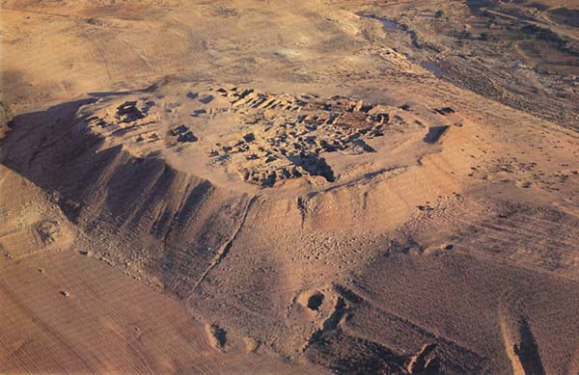
The Stronghold of Ziklag:
A New Home: I Sam 27:3-12
Notes:
Read passage, may or may not be Ziklag precisely, but still and equivalent representation;
This was not a Philistine city, but a vassal city, donated by Achish to David
Tell es-Seba‘, long identified as Biblical Beer-Sheva, lies 4 miles east of the modern city of Beer-Sheva, …
Archaeologist Volkmar Fritz disagrees that the tell is ancient Beer-Sheva. ….
The misidentified Tell es-Seba‘, he asserts, is Ziklag, the town given to David by Achish…..
http://members.bib-arch.org/publication.asp?PubID=BSBA&Volume=19&Issue=3&ArticleID=8

Slide 18
Philistine Conquests c. 1000BC:
Notes:
-Show possible site of Ziklag? Or Beer-Sheba?
-In either case, David is “out of the way”…he is farther from his true home,
But also securely out of reach of Saul

Slide 19
Did David Lie to Achish?
Why?
Was This Justified?
Notes:
Poll the audience
-Yes he lied
-Out of fear, lack of faith..?
-David is unclear at this stage of his life, think back he cut off Saul’s robe, then regrets
-The text does not say he was instructed by God to lie OR initiate those particular raids
-Bad example to the mighty men who trusted David with their lives!

Slide 20
More Mighty Men – A Great Army:
Widespread Influence
Tribe of Benjamin, Saul’s family (v. 2)
Tribe of Gad (v.8)
Men of Judah (v.16)
Tribe of Manessah (v.19)
Skilled Warriors (I Chron 12:1-22)
Bowmen (v. 2)
Slingers of Stones (v. 2)
Expert with Shield and Spear (v. 8)
Very brave, fast (v. 8)
Notes:
-David’s victories while living at Ziklag increased the size of his army greatly
-Pivotal point in rise to power
-But David is winning popularity here, some who love the things of God (II Sam 15:18-23)
along with others who don’t really care
“everyone loves a winner”

Slide 21
Payback:
Ziklag destroyed by Amalekites (I Sam 30:1)
Loved ones kidnapped (I Sam 30:2)
The men spoke of stoning David (I Sam 30:6)
“bitter in soul”
II Sam 22:2
“…everyone who was bitter in soul gathered to him...”
Notes:
-David suffers a consequence of his rash actions against the Amalekites
-A similar phrase is repeated here from 22:2, showing that these mighty men
-are prone to anger, bitterness; just as quick to turn away from David as they
were to turn to him
-This could have been the end of David

Slide 22
Good Leadership By Example:
Tears until exhaustion (I Sam 30:4)
David strengthened himself in the Lord (I Sam 30:6)
David inquired of the Lord (I Sam 30:7-8)
Notes:
-David may have written a Psalm at this time, to encourage his faith
-He led by example, asking God for guidance; admitting by inference his previous failure to do so
-The men do not question the Divine response, as they did back at Keilah

Slide 23
What Makes a Mighty Man?
A New Rule In Israel: I Sam 30:17-25
Perseverance (I Sam 30:9-10)
Fair treatment (I Sam 30:23-25)
- A Shared Experience -
Notes:
-Our goal with these classes is to learn what makes a mighty man “or woman” in Gods eyes
With God’s help David makes the best of a terrible situation
-”wicked and worthless fellows” (v.22) are put under authority
-fair distribution of spoils, even to those who could not fight
David and his men learn together, David does not “know all”
He is human, admits mistakes, and loves God, an example
for relationships in the world and the ecclesia
– Respect others and learn together

